Slide 1
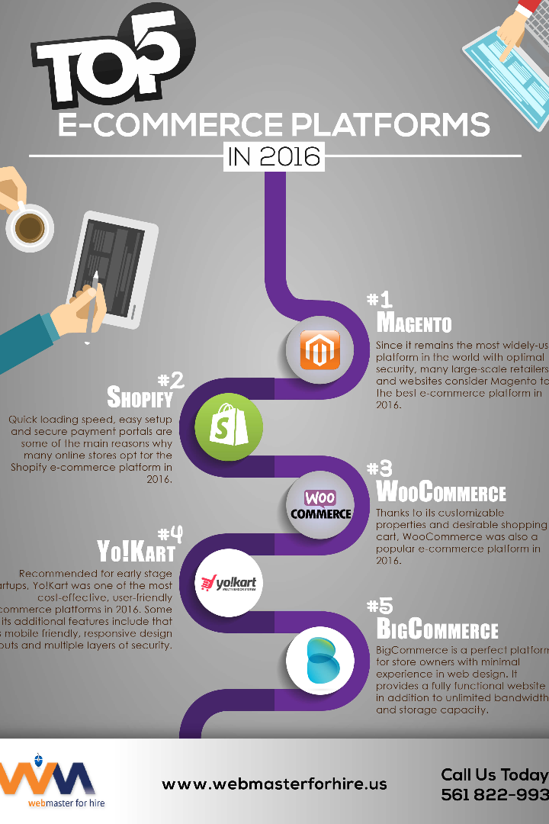
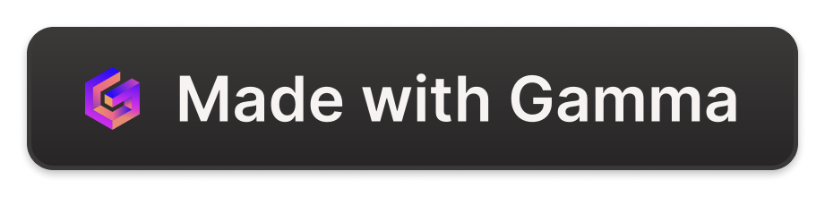
Building the Artisanal E-commerce Platform on IBM Cloud Foundry
Discover the power of IBM Cloud Foundry in creating a robust and scalable artisanal e-commerce platform. Explore the benefits and step-by-step process of building and deploying the platform.
er
by elamathi ravi

Slide 2

Introduction
This presentation aims to showcase the immense potential of the artisanal e-commerce platform and the significant advantages of utilizing IBM Cloud Foundry. Get ready to embark on a journey of innovation and success.

Slide 3

Understanding IBM Cloud Foundry
Enter the world of IBM Cloud Foundry, a cutting-edge cloud platform that offers high availability, scalability, and flexibility. Learn about its key features and why it's the ideal choice for your e-commerce platform.

Slide 4
Building the Artisanal E-commerce Platform
1
Step-by-Step Process
Uncover the secrets to building a top-notch artisanal e-commerce platform. From conceptualization to development, we'll lead you through the entire journey.
Design Considerations
2
Dive into the world of aesthetics and functionality. Learn best practices for creating an exceptional user experience and effective design elements.
3
Integration of Key Modules
Explore the integration of essential modules, such as inventory management, secure payment gateways, and seamless order processing.
Scaling and Performance
4
Discover techniques for optimizing performance and scaling your platform to accommodate a growing customer base, ensuring an unforgettable shopping experience.

Slide 5
Deploying on IBM Cloud Foundry
Environment Setup
Configuration and Upload
Learn how to set up an environment suitable for deploying the artisanal e-commerce platform on IBM Cloud Foundry.
Step through the process of uploading and configuring the platform, ensuring seamless integration and functionality.
Testing and Quality Assurance
Validation and Launch
Put your platform to the test. Discover strategies to ensure every feature is functioning flawlessly and guarantee customer satisfaction.
Once the platform is fully tested, ensure its readiness for launch and seize the opportunity to introduce it to eager customers.

Slide 6

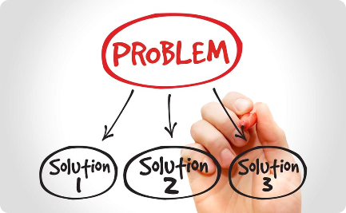

Managing and Scaling the Platform
Monitoring & Maintenance
Troubleshooting & Support
Scaling & Optimization
Explore strategies for scaling your platform to handle increased traffic while optimizing its performance for unmatched user experience.
Ensure the smooth operation of your platform. Discover efficient techniques for monitoring and maintaining critical systems.
Overcome common technical challenges and provide outstanding support to keep your platform running seamlessly.

Slide 7

Conclusion
In summary, IBM Cloud Foundry empowers the creation of a robust and scalable artisanal e-commerce platform. Discover the multitude of benefits that come with utilizing this platform and embrace the future of online commerce. Time for some Q&A!

